Slide 1
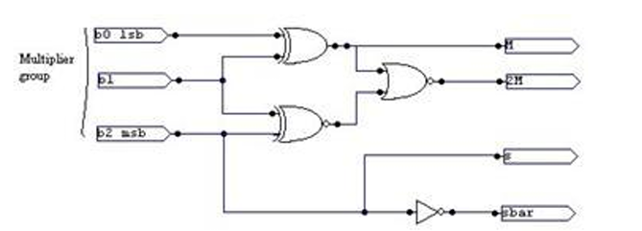
BOOTH’S ENCODER
ROLL NO: 2310040060 2310040077
2310040091 2310040112
2310049143

Slide 2
INTRODUCTION
Booth Encoding is an effective method which greatly increase the speed of our algebra as its output. Booth's encoding, a technique developed by Andrew D. Booth, is a method for speeding up binary multiplication by reducing the number of partial products needed. It works by encoding the multiplier bits in a way that minimizes the number of times the multiplicand needs to be added or subtracted. This reduction in partial products leads to faster multiplication, particularly for signed numbers.

Slide 3
ELABORATION:
Reducing Partial Products:
Booth's encoding re-codes the multiplier bits to represent consecutive sequences of 1s as a single value, effectively reducing the number of partial products that need to be generated and added.
Radix-2 and Radix-4:
Common variations include Radix-2 (also known as Modified Booth's encoding) and Radix-4, with Radix-4 further reducing the number of partial products by half compared to Radix-2.
Handling Signed Numbers:
Booth's algorithm can efficiently handle signed binary numbers represented in two's complement notation, making it useful for a wide range of applications.

Slide 4
APPLICATIONS
Booth's encoding is widely used in computer architecture and digital signal processing for efficient multiplication of signed binary numbers. Booth multipliers are primarily used in digital signal processing (DSP) and high-performance computing (HPC) for efficient multiplication of signed binary numbers. They are also valuable in embedded systems and microcontrollers where resource-efficient algorithms are crucia

Slide 5
IMPLEMENTATION
Booth's algorithm can be implemented by repeatedly adding (with ordinary unsigned binary addition) one of two predetermined values A and S to a product P, then performing a rightward arithmetic shift on P.
Booth multiplication is the fastest way to multiple binary number.
Number of steps in booth multiplication are equal to the number of bits. We are using a half adder to construct a full adder . Full adder is used for making addition of two number(bits) possible.

Slide 6
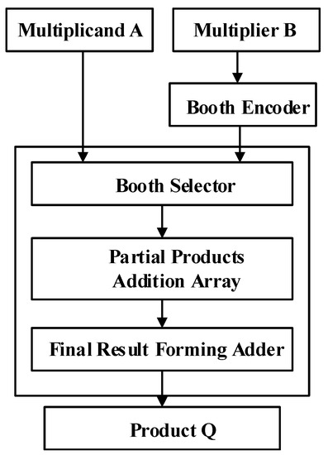

Slide 7
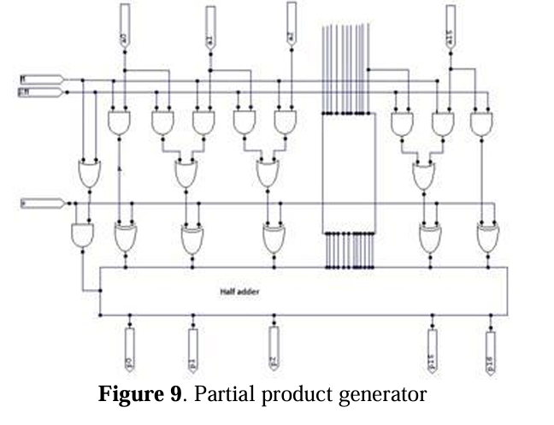
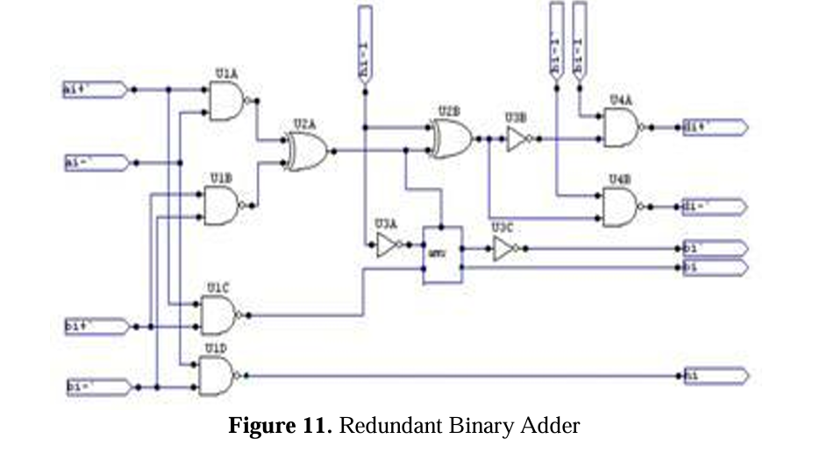

Slide 8
LOGIC GATES used
1. AND gates
Used to detect specific bit patterns in the multiplier group.
2. OR gates
Used to combine signals from different comparisons.
3. NOT gates (Inverters)
Used to invert bits to help detect certain patterns like 10 or 01.
4. XOR gates
Used in some implementations to simplify logic when determining control signals
5. Multiplexers (MUX)
While not a "gate" per se, they're often built from basic gates and are used to select the correct operation (add, subtract, shift, etc.) based on the encoding.

Slide 9
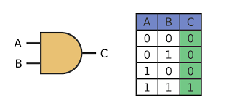
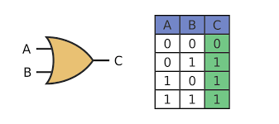
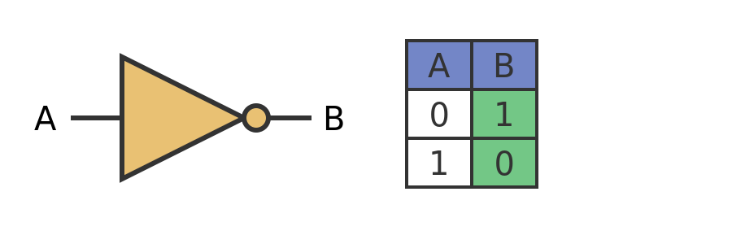
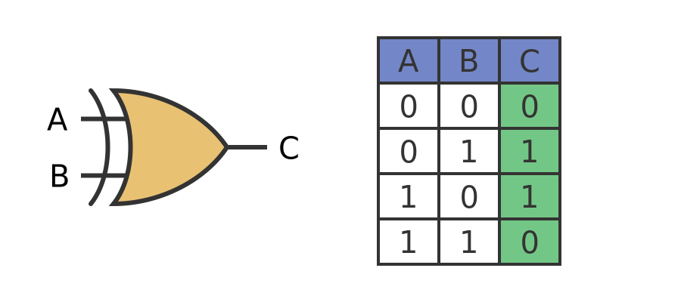
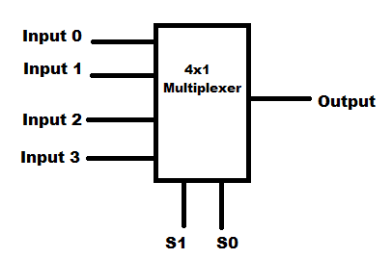

Slide 10
Conclusion
In conclusion, Booth's encoding offers a significant optimization for binary multiplication, particularly when dealing with signed numbers, by reducing the number of arithmetic operations required. This efficiency translates to faster execution, lower hardware resource utilization, and reduced power consumption, making it a valuable technique in various digital systems, including processors and DSPs

